Slide 1
Cluster Analysis
—— Yizhu
2017.10.25
Notes:
I'm going to systematically introduce you the concepts and methods of cluster analysis.

Slide 2
Category
What is cluster analysis
Similarity Measure
Cluster Method and Application
Partitioning-Based Clustering Method
Hierarchical Clustering Method
Density-Based Clustering Method
Grid-Based Clustering Method
Cluster Evaluation

Slide 3
What is cluster analysis
Cluster
A cluster is a collection of data objects which are -Similar to one another within the same group (i.e., cluster) -Dissimilar to the objects in other groups (i.e., clusters)

Slide 4
What is cluster analysis
Cluster analysis (or clustering)
Given a set of data points, partition them into a set of groups (clusters)
Cluster analysis is unsupervised learning (no predefined classes) This contrasts with classification (supervised learning)

Slide 5
What is cluster analysis
Typical ways to use/apply cluster analysis
Stand-alone tool
Preprocessing step

Slide 6
Similarity Measures
Similarity function
Similarity between two data objects The higher value, the more alike Range [0,1]: 0: no similarity; 1: completely similar
Distance function
Difference between two data objects The lower, the more alike  Range [0, 1] or [0, ∞)
Notes:
a real value function to quantify the similarity
Usually the higher value, it means more similar.
how different these two objects are.
the lower or the shorter the distance, the more alike.

Slide 7
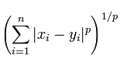
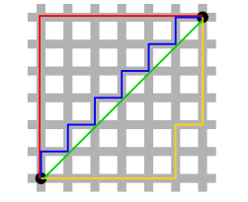
Similarity Measures
Distance
Minkowski Distance =
P = 1 —> Manhattan Distance
P = 2 —> Euclidean Distance
Notes:
P is a variable
Straight line distance
the object is mapped to a vector in the vector space,
compute the distance between the vectors.

Slide 8
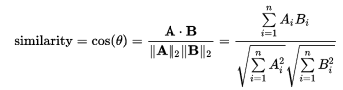
Similarity Measures
Similarity
Cosine Similarity
Notes:
similarity between two non-zero vectors of an inner product space
calculate the relation between objects

Slide 9
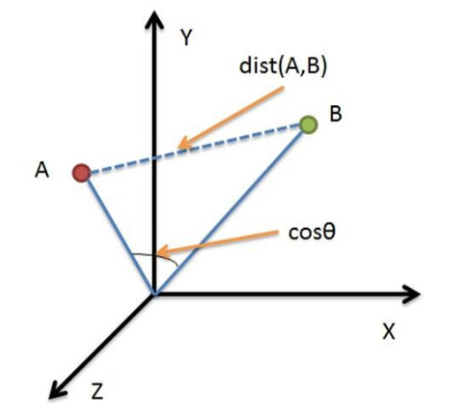
Similarity Measures
Quiz
What is the difference between Euclidean Distance and Cosine Similarity?
Position
Direction
(100,50) (1000,500)
(100,50) (1000,500)
normalization
Notes:
Absolute distance based on Position
Angle Direction
How different
If have correlation
Indicate the changing of the price for different commodity
Data in different type

Slide 10
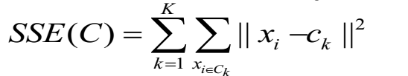
Cluster Method— Partitioning-Based Clustering Methods
K-partitioning method:
— Partitioning a dataset D of n objects into a set of K clusters so that an objective function is optimized
A typical objective function: Sum of Squared Errors (SSE)
Notes:
for example,
c k is the centroid of cluster capital C k.
Minimized SSE

Slide 11
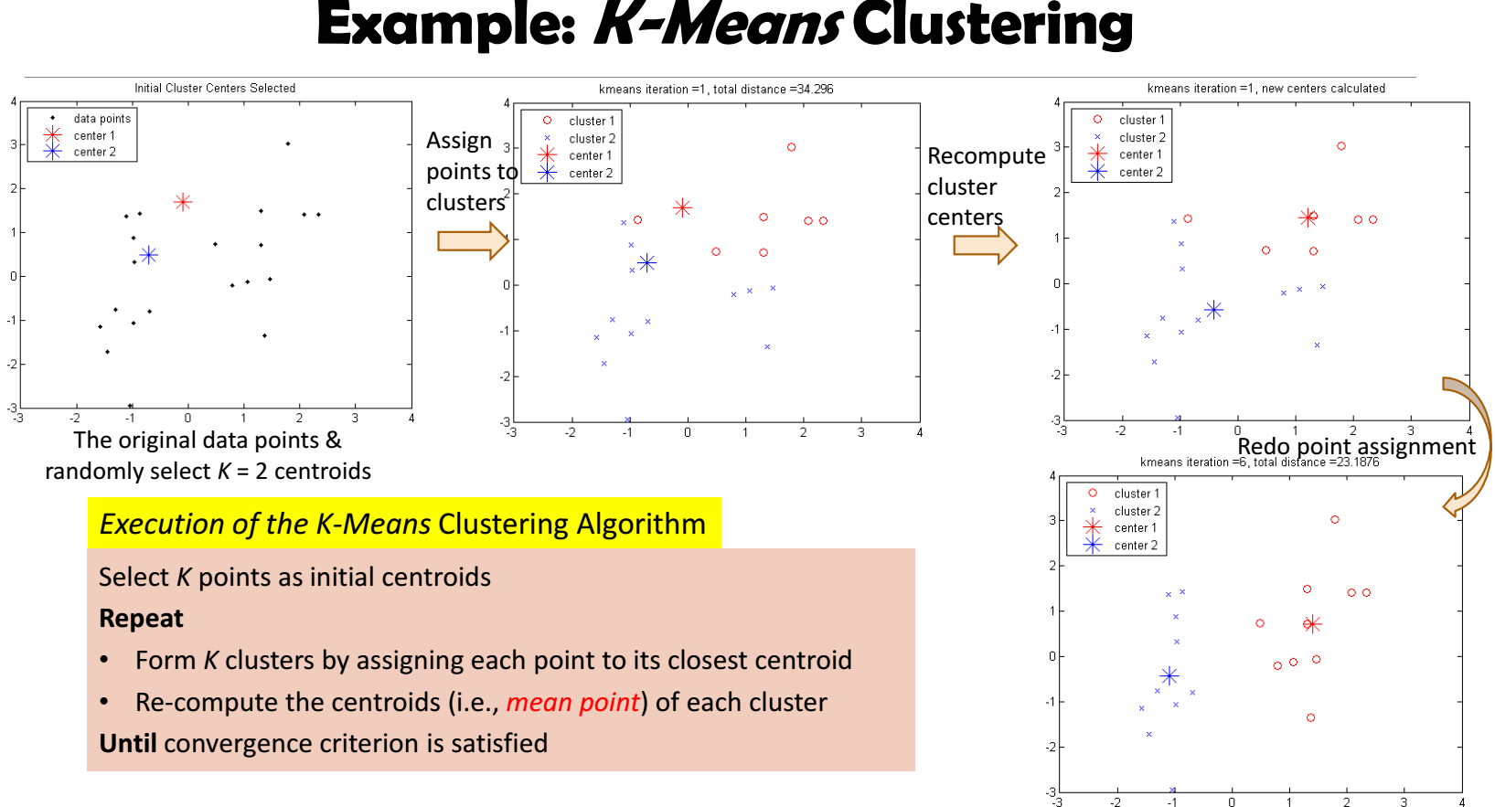
K-Means
Notes:
Until the cluster is stable

Slide 12
K-means
Efficiency:
O(tKn): n: # of objects, K: # of clusters, and t: # of iterations
Normally, K, t << n; thus, an efficient method
Quiz:
Problems of K-Means?
Improvement:
The choice of the initial centroids
Sensitive to noisy data and outliers
Not suitable to discover clusters with non-convex shapes
Need to specify K, the number of clusters

Slide 13
K-means
Efficiency:
O(tKn): n: # of objects, K: # of clusters, and t: # of iterations
Normally, K, t << n; thus, an efficient method
Improvement:
The choice of the initial centroids
Sensitive to noisy data and outliers
Not suitable to discover clusters with non-convex shapes
Need to specify K, the number of clusters

Slide 14
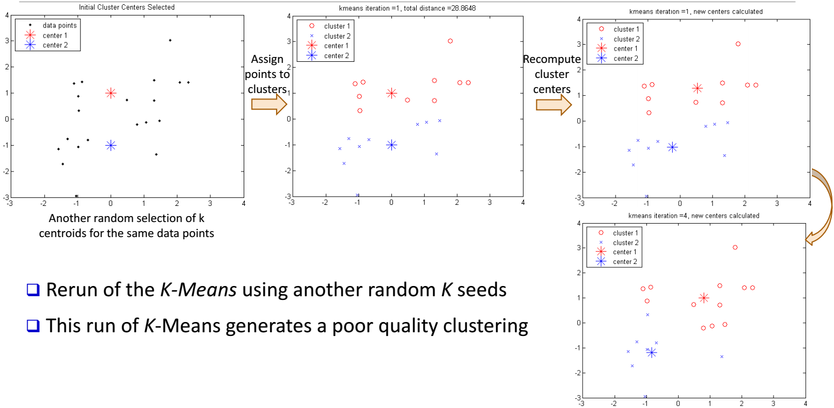
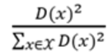
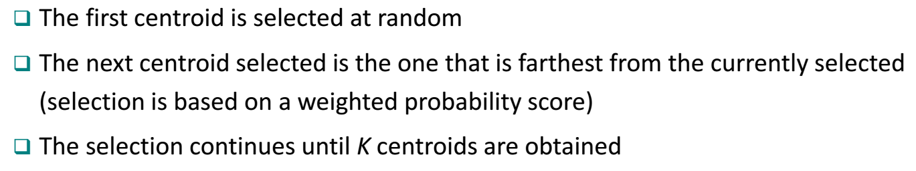
K-means++
Notes:
Farthest form each other
D(x) the distance between the x and its nearest centroids

Slide 15
K-means
Efficiency:
O(tKn): n: # of objects, K: # of clusters, and t: # of iterations
Normally, K, t << n; thus, an efficient method
Improvement:
The choice of the initial centroids
Sensitive to noisy data and outliers
Not suitable to discover clusters with non-convex shapes
Need to specify K, the number of clusters

Slide 16
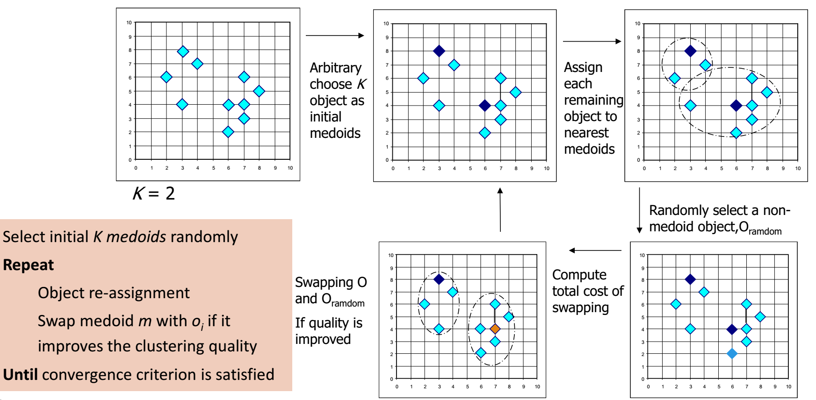
K-Medoids
Notes:
If the SSE of the clusters become smaller
The centroid is a real point in the cluster

Slide 17
K-means
Efficiency:
O(tKn): n: # of objects, K: # of clusters, and t: # of iterations
Normally, K, t << n; thus, an efficient method
Improvement:
The choice of the initial centroids
Sensitive to noisy data and outliers
Not suitable to discover clusters with non-convex shapes
Need to specify K, the number of clusters

Slide 18
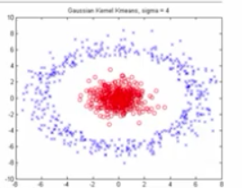
Kernel K-means
Idea:
High-dimensional space, Kernel function
K-means algorithm

Slide 19
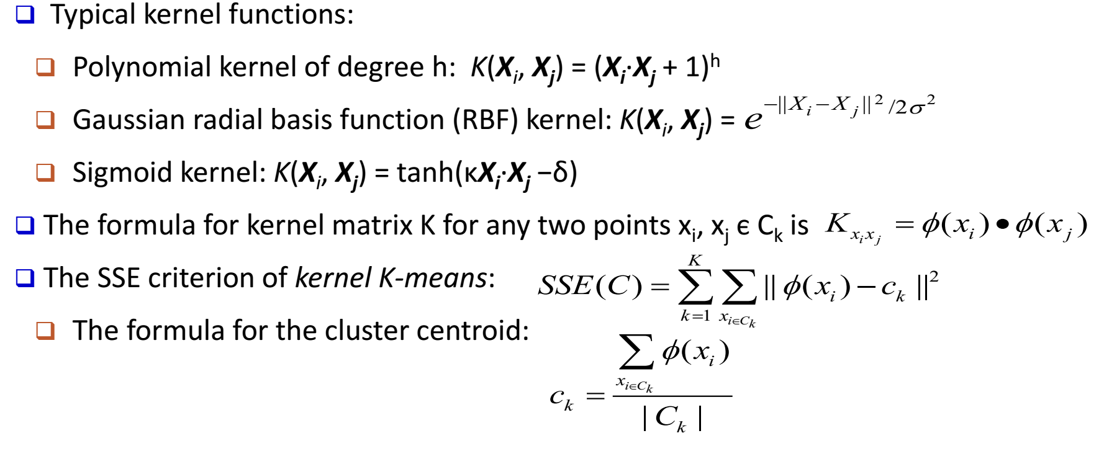
Kernel K-means
Notes:
Centroid like k-means

Slide 20
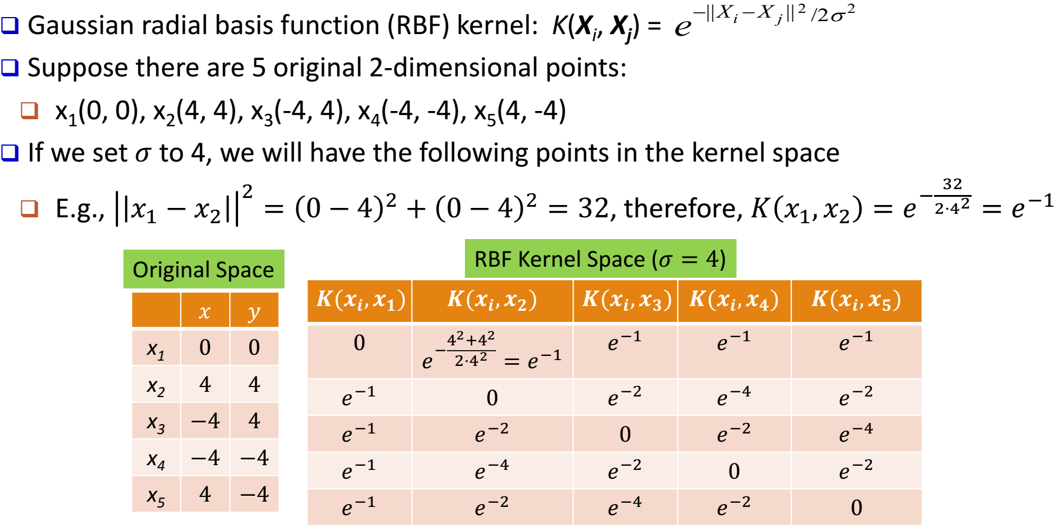
Kernel K-means
Notes:
N by n matix

Slide 21
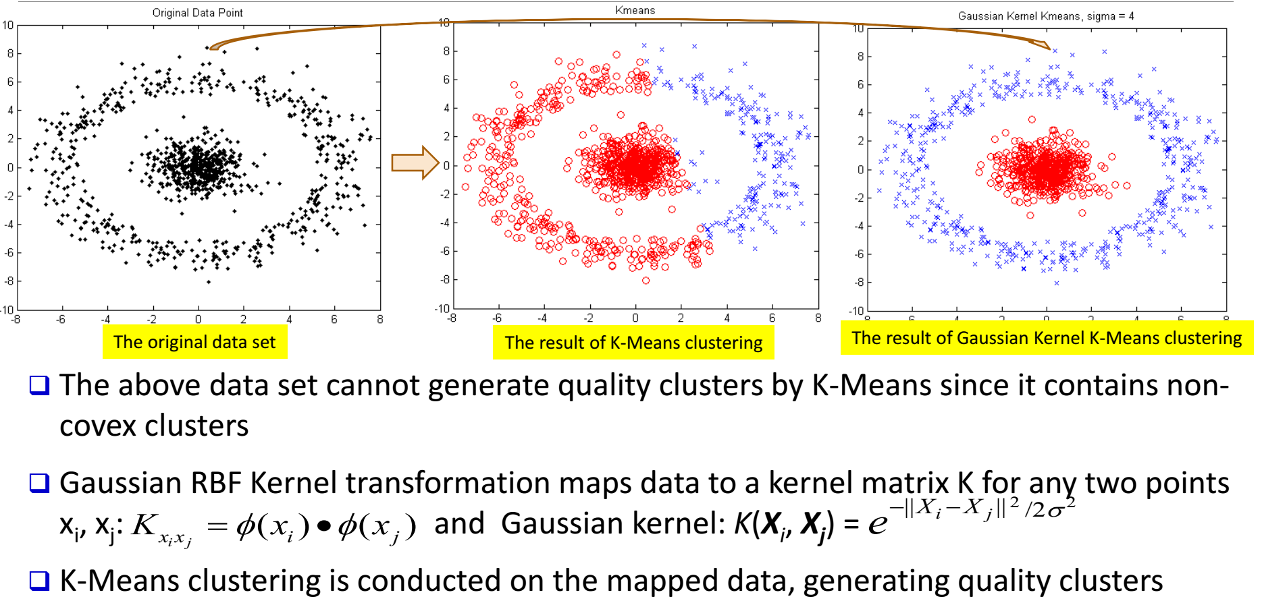
Kernel K-means

Slide 22
K-means
Efficiency:
O(tKn): n: # of objects, K: # of clusters, and t: # of iterations
Normally, K, t << n; thus, an efficient method
Improvement:
The choice of the initial centroids
Sensitive to noisy data and outliers
Not suitable to discover clusters with non-convex shapes
Need to specify K, the number of clusters

Slide 23
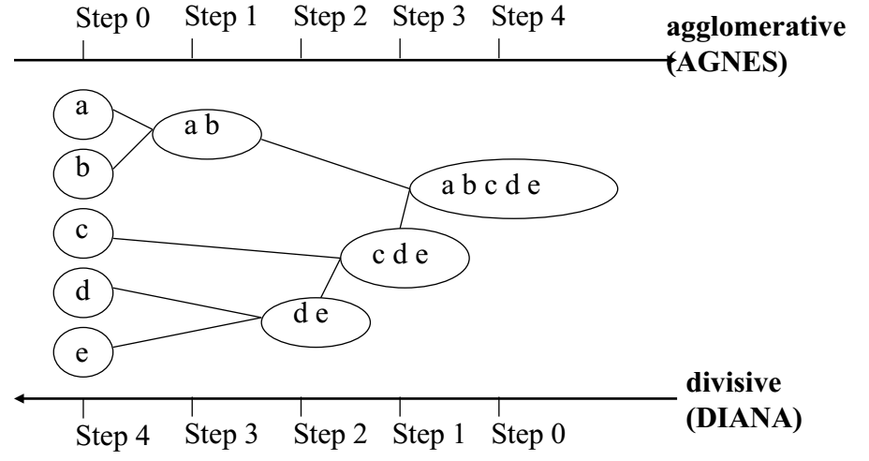
Cluster Method — Hierarchical Clustering Methods
Generate a clustering hierarchy (drawn as a dendrogram)
Not required to specify K, the number of clusters
More deterministic
No iterative refinement
bottom-up
top-down
Notes:
start with singleton clusters, continuously merge two clusters at a time.
start with a huge cluster, then split them continuous into two groups. It will generate a top-down hierarchy of clusters.

Slide 24
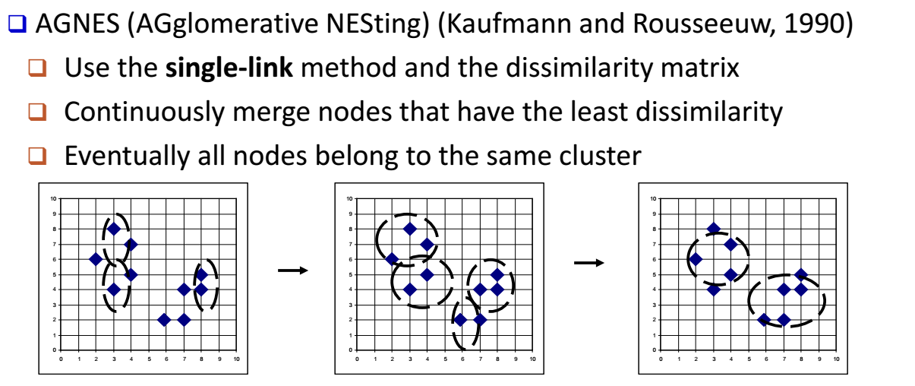
Agglomerative Clustering Algorithms

Slide 25
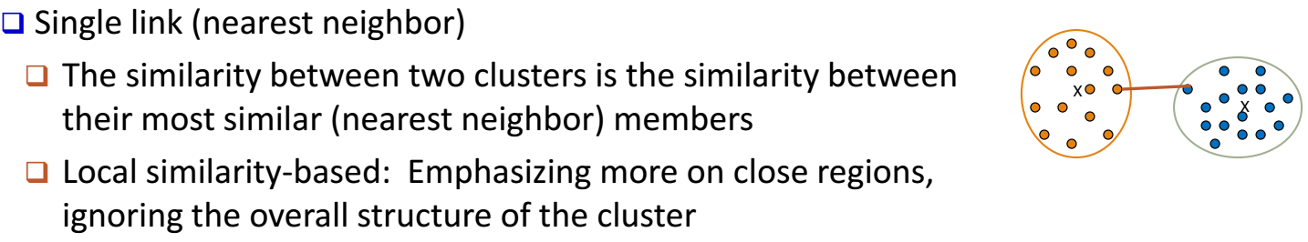
Agglomerative Clustering Algorithms

Slide 26
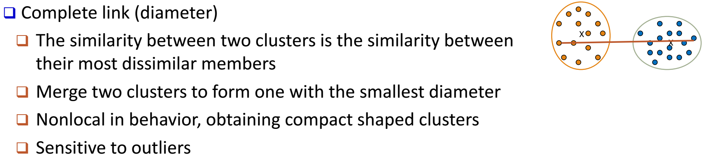
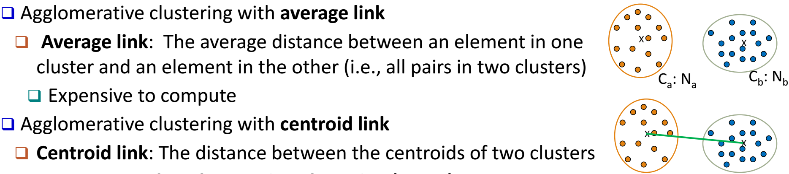
Agglomerative Clustering Algorithms

Slide 27
Agglomerative Clustering Algorithms
Notes:
That means you start from the singleton, you try to find everyone's nearest neighbor.
Then you check the closest nearest neighbor, try to merge them.
Repeat

Slide 28
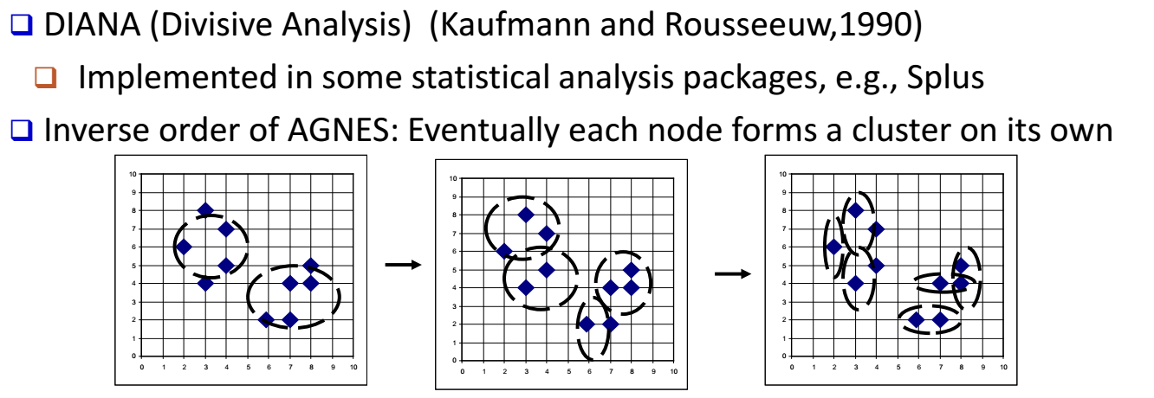
Divisive Clustering Algorithms

Slide 29
Divisive Clustering Algorithms
Choose which cluster to split: the value of SSE
How to split the cluster: difference of SSE
Notes:
If you have multiple clusters now, you can check the SSE of the clusters, and see which one is the largest one.

Slide 30
Cluster Method — Hierarchical Clustering Methods
Advantage:
Not need specify K, the number of clusters
Not generate globular clusters
Disadvantage:
Irreversible process

Slide 31
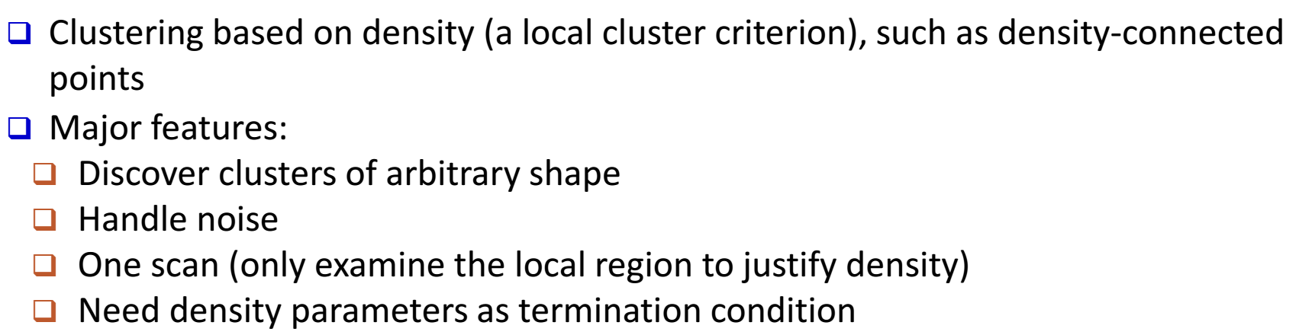
Cluster Method — Density-Based Clustering
Notes:
look at surroundings to see how dense this region could be.
we It You it

Slide 32
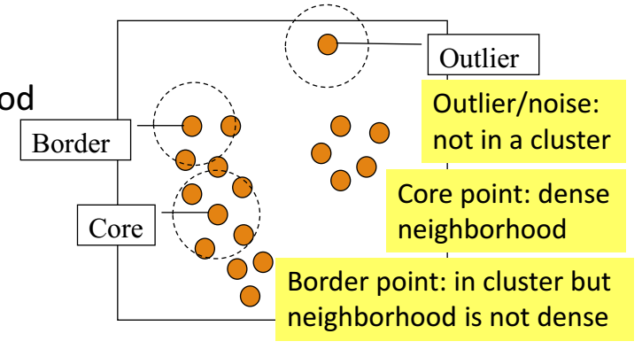
Density-Based Clustering — DBSCAN
A density-based notion of cluster A cluster is defined as a maximal set of density-connected points
Notes:
For example, DBSCAN

Slide 33
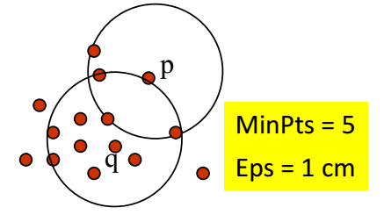
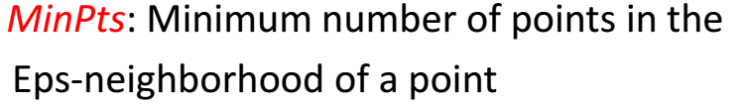
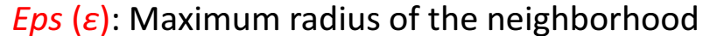
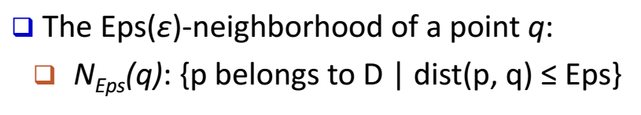
Density-Based Clustering — DBSCAN

Slide 34
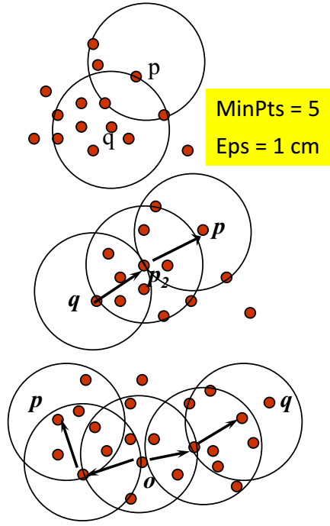
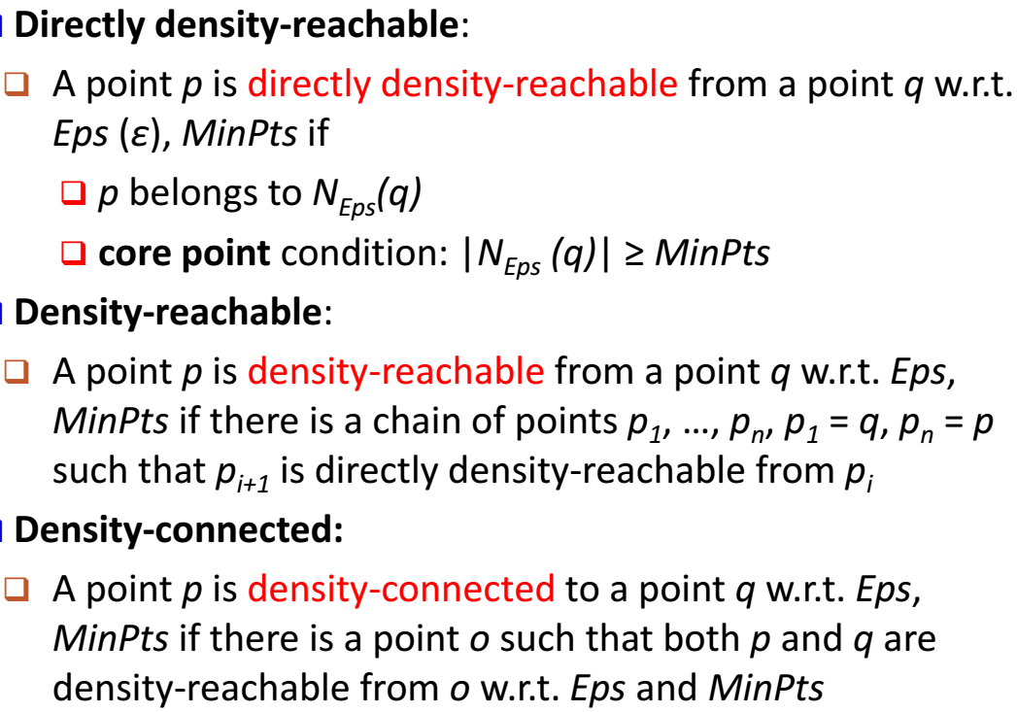

Slide 35
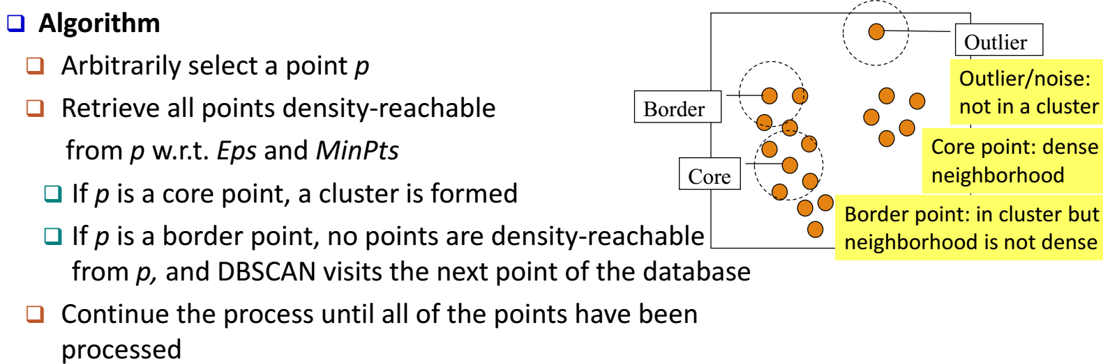
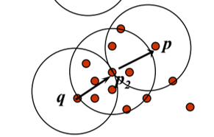
Density-Based Clustering — DBSCAN

Slide 36
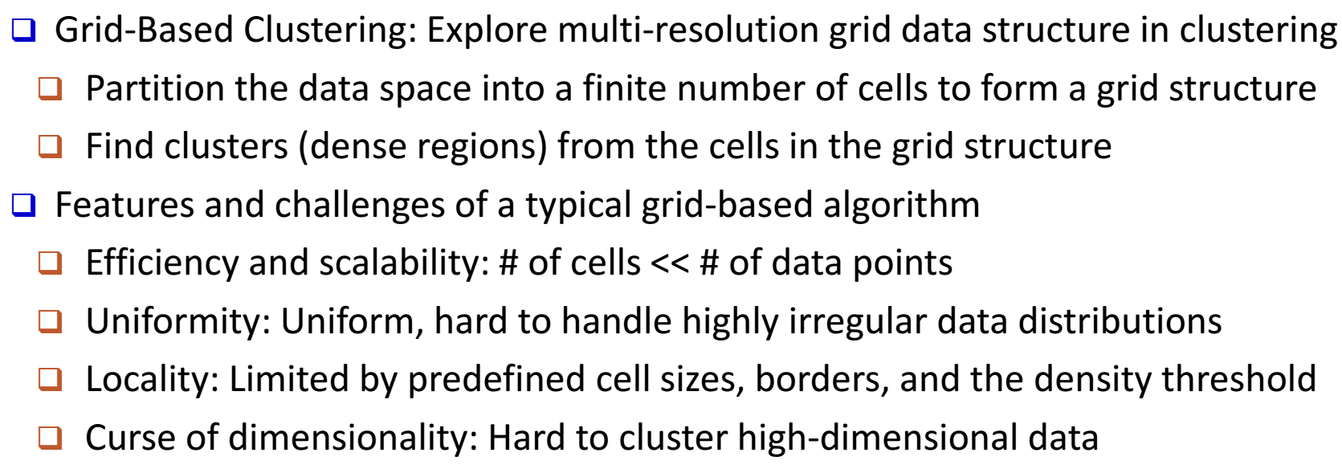
Cluster Method — Grid-Based Clustering
Notes:
The number of the data points is smaller
It's a 3D uniform structure…

Slide 37
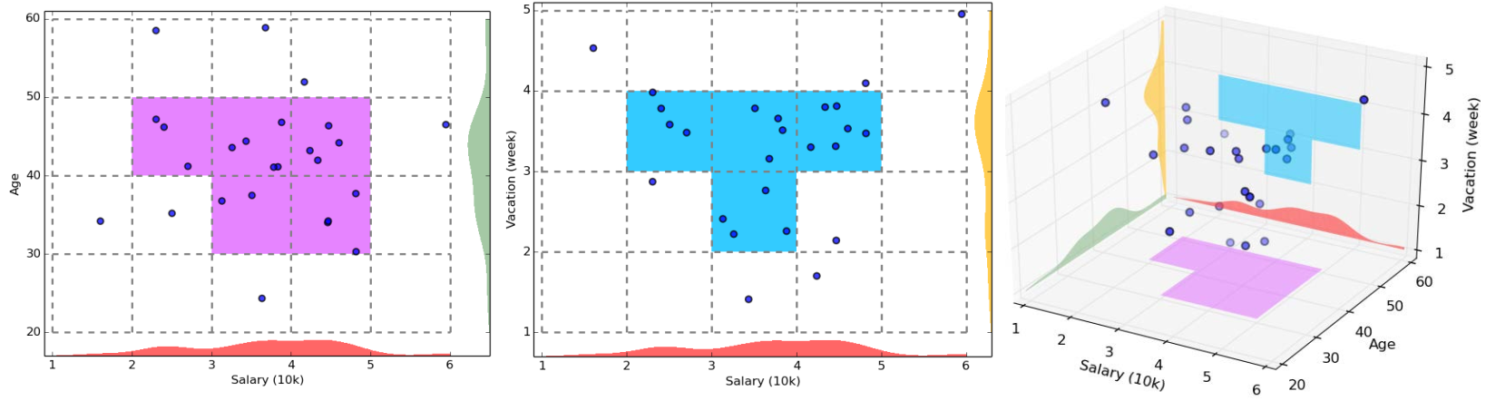
Grid-Based Clustering — CLIQUE
Identify subspace that contains clusters
Identify clusters
Generate the minimal descriptions of the cluster
Notes:
partition the database space into the grid structure,
then find the number of points that lie inside each cell…
Apriori principle.
By Density based …
The points in one cluster need appear in the same cluster within both two different planes.

Slide 38
Cluster Application
Data summarization, compression, and reduction
Collaborative filtering, recommendation systems,…
- Dynamic trend detection
- Multimedia data analysis, biological data analysis,…
- A key intermediate step for other data mining tasks

Slide 39
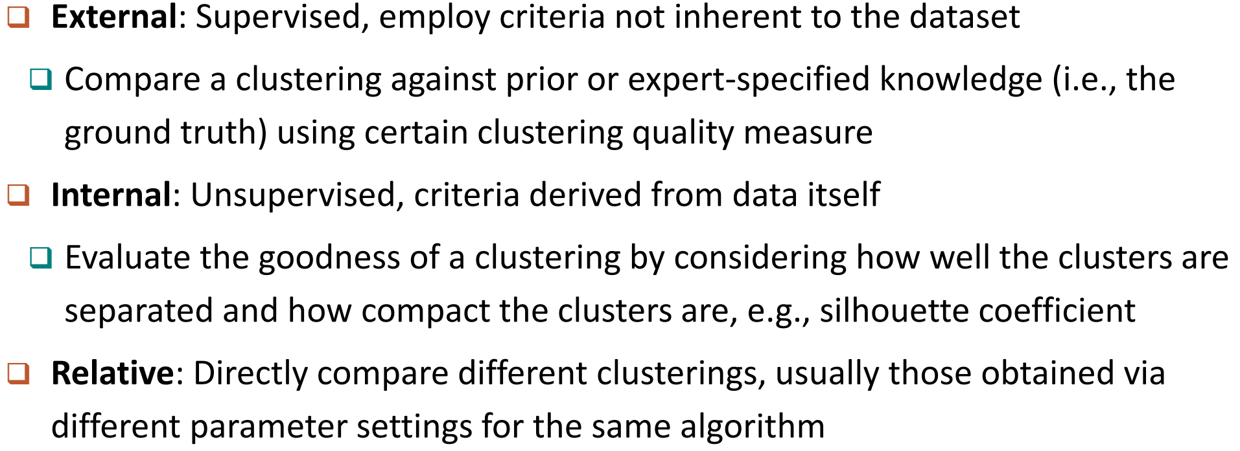
Cluster Evaluation

Slide 40
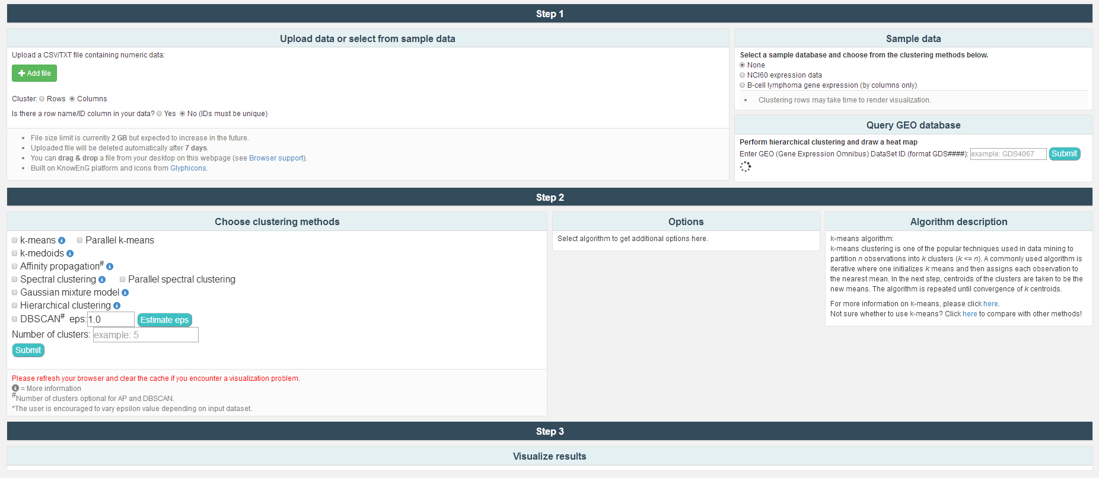
ClusterEnG http://education.knoweng.org/clustering/index.php.
ClusterEnG is an interactive platform for clustering analysis, developed by the Computational Biology Group at UIUC.

Slide 41
Thank you !

